Slide 1

CHATBOT INTEGRATION WITH SLACK

Slide 2

Integrating an Amazon Lex Bot with Slack
Step 1: Create an Amazon Lex Bot
Step 2: Sign Up for Slack and Create a Slack Team
Step 3: Create a Slack Application
Step 4: Integrate the Slack Application with the Amazon Lex Bot
Step 5: Complete Slack Integration
Step 6: Test the Integration

Slide 3
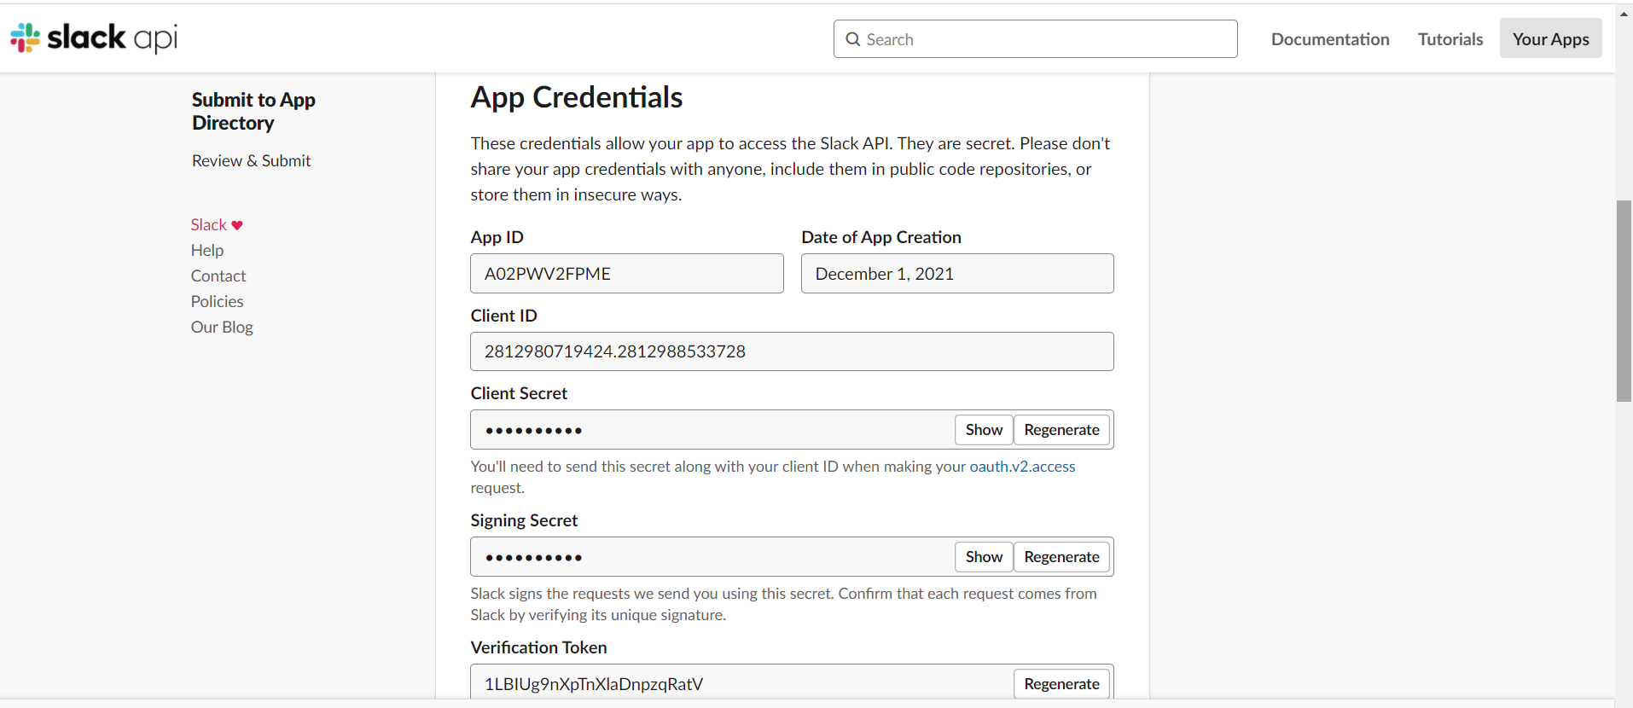
1. Modify Lex Configurations with Slack App Credentials

Slide 4
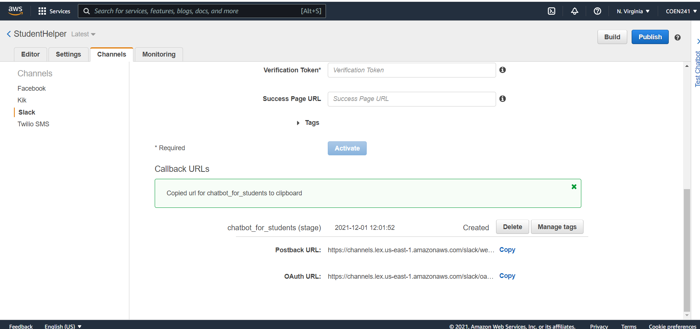
2. Obtain Postback URL and OAuth URL

Slide 5
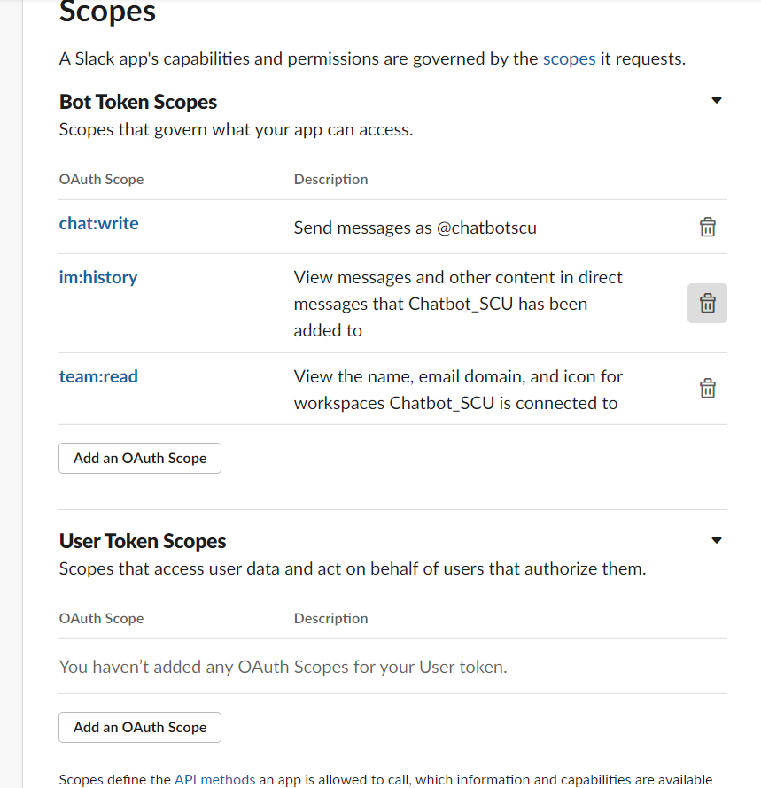
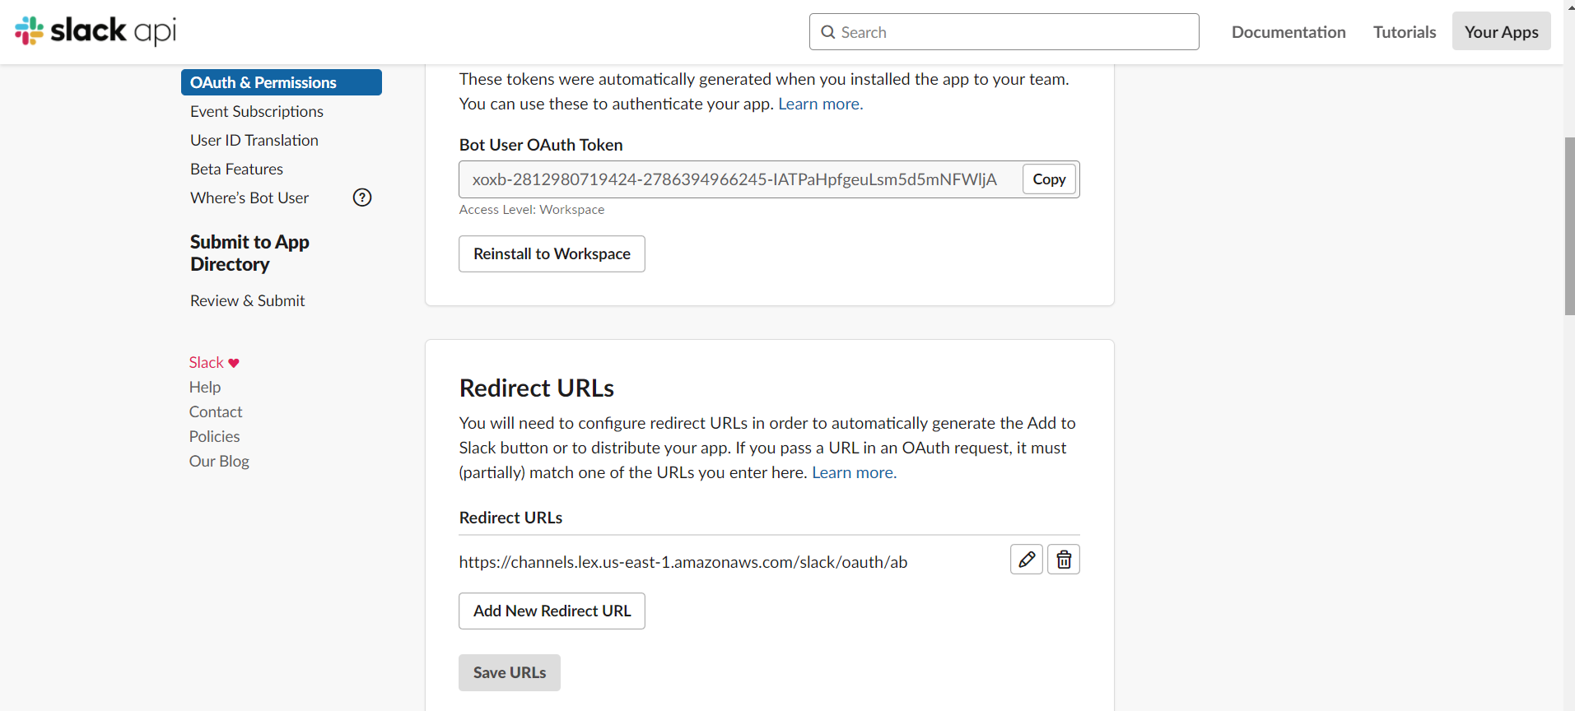
3.1.Modify Slack Admins Page Ports And Permissions by first modifying OAuths and Permissions : copy the OAuth URL and paste to Redirect URL
3.2. Add scope

Slide 6
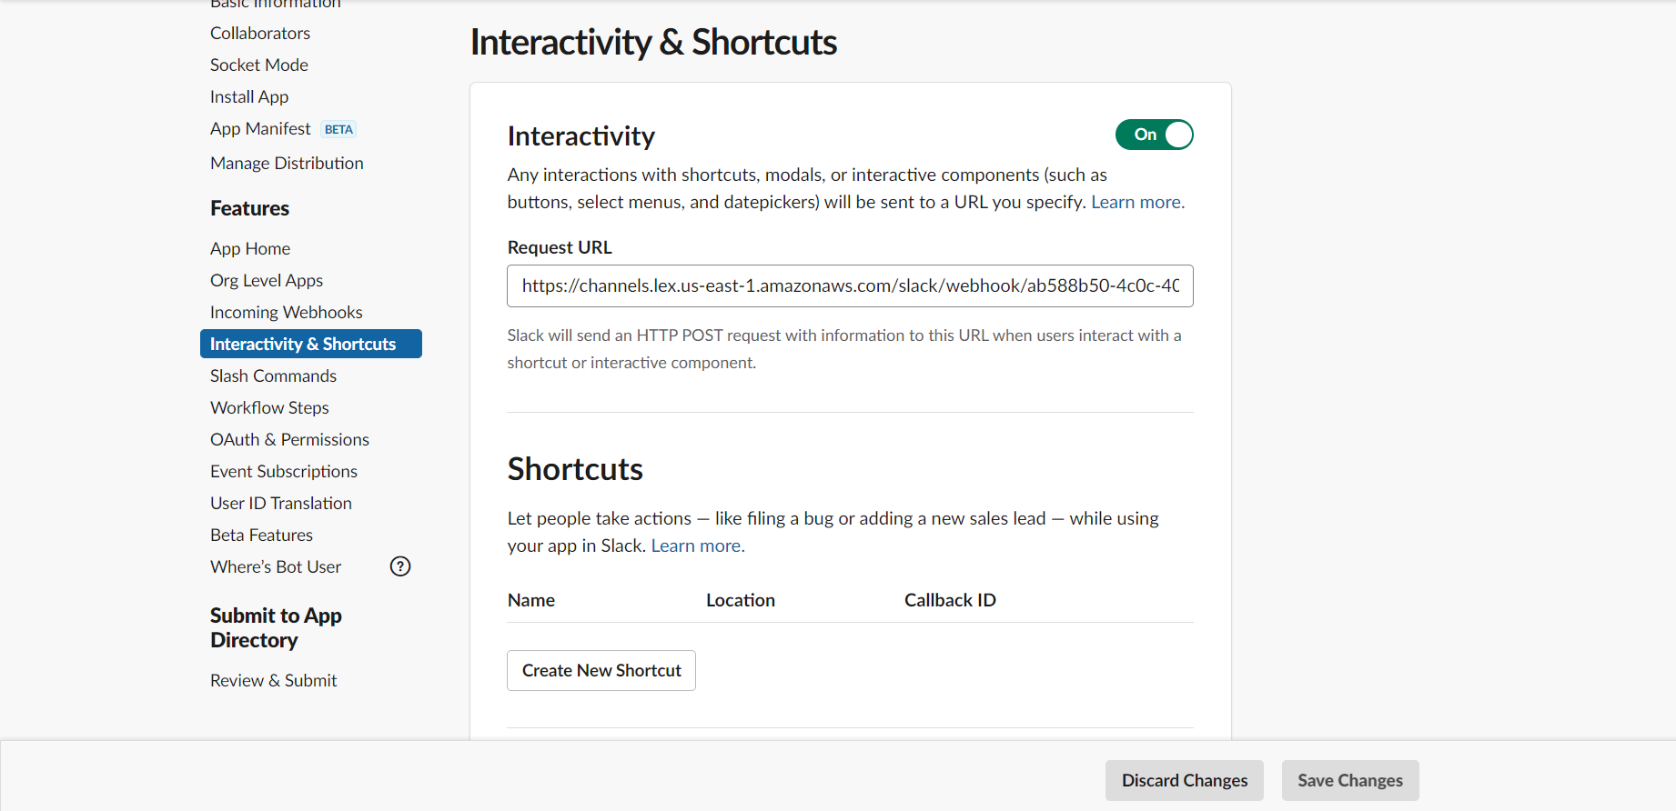
4. Modify Slack Admins Page Ports And Permissions by then modifying Interactive Components : copy the Postback URL and paste to Request URL

Slide 7
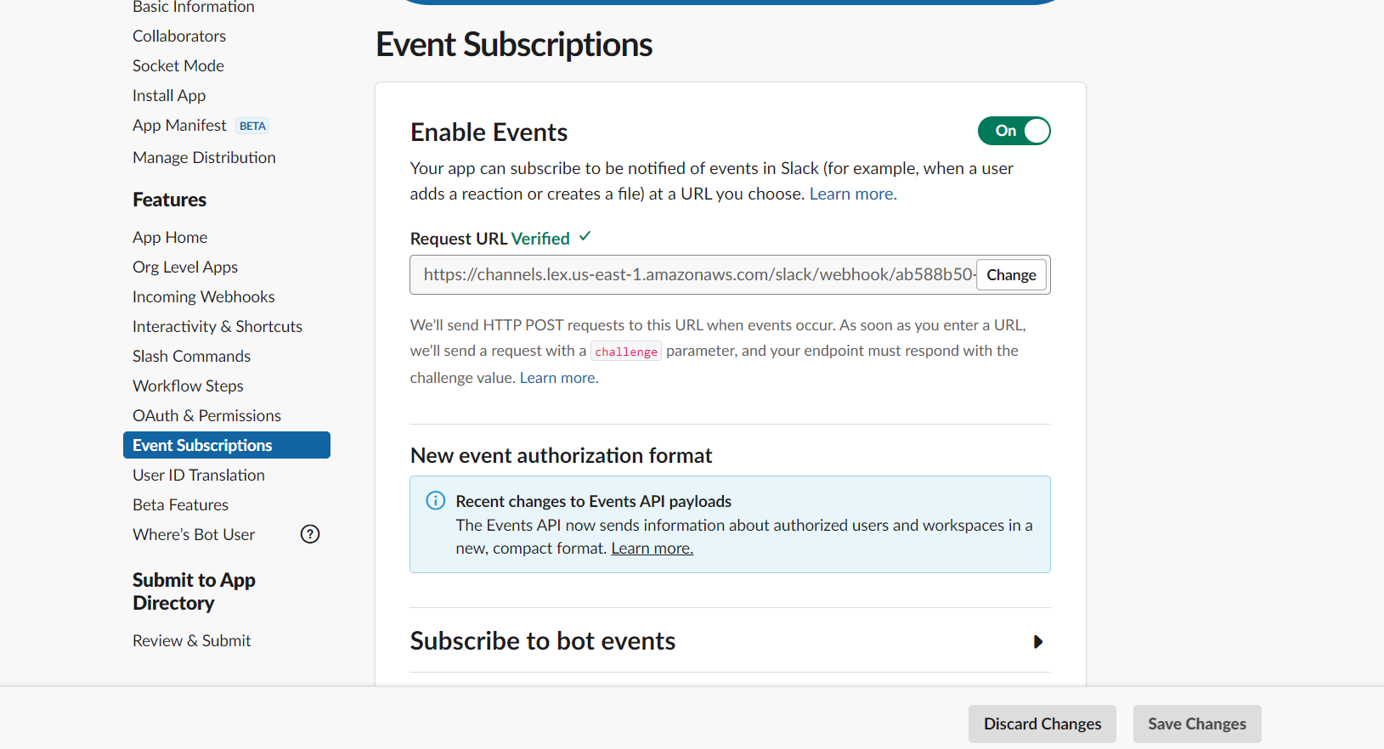
5. Enable Event Subscription and paste Postback URL to request URL

Slide 8
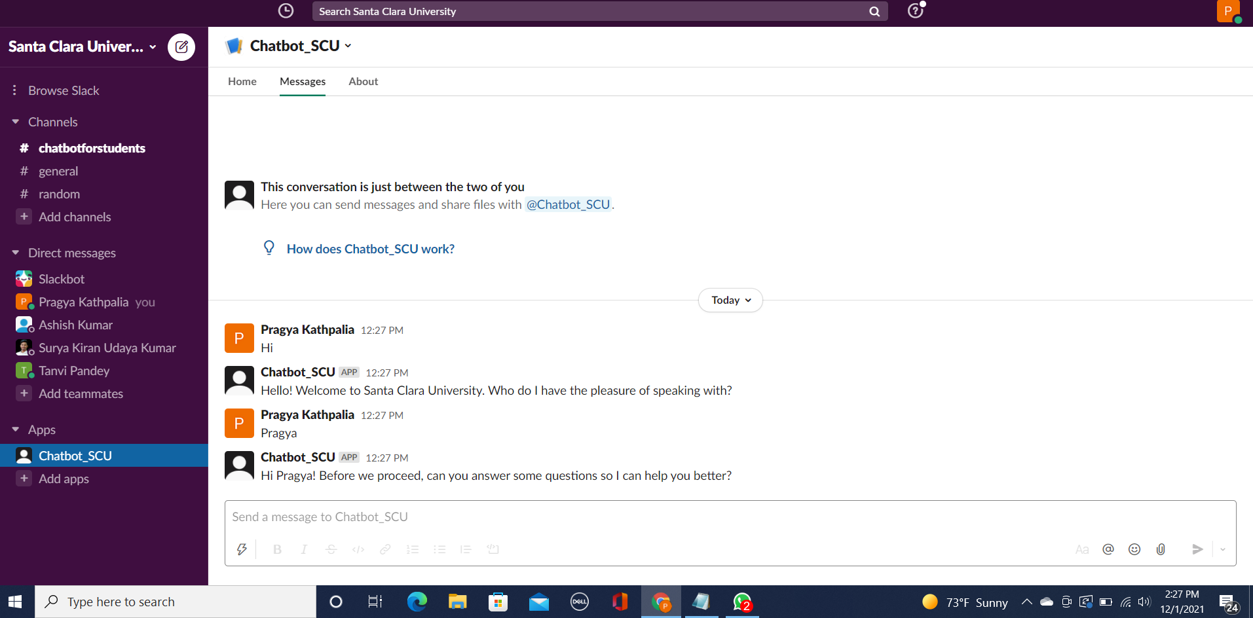
6. Install app to workspace and add it to slack

Slide 9
App’s current info, settings & configurations in JSON format
{
"_metadata": {
"major_version": 1,
"minor_version": 1
},
"display_information": {
"name": "Chatbot_SCU",
"description": "Santa Clara University Chatbot",
"background_color": "#1d3275"
},
"features": {
"app_home": {
"home_tab_enabled": true,
"messages_tab_enabled": false,
"messages_tab_read_only_enabled": false
},

Slide 10
,
"bot_user": {
"display_name": "Chatbot_SCU",
"always_online": true
}
},
"oauth_config": {
"redirect_urls": [
"https://channels.lex.us-east-1.amazonaws.com/slack/oauth/ab588b50-4c0c-4051-9321-dda9ebe3ad32"
],
"scopes": {
"bot": [
"chat:write",
"team:read",
"im:history"
]
}
},

Slide 11
"settings": {
"event_subscriptions": {
"request_url": "https://channels.lex.us-east-1.amazonaws.com/slack/webhook/ab588b50-4c0c-4051-9321-dda9ebe3ad32",
"bot_events": [
"message.im"
]
},
"interactivity": {
"is_enabled": true,
"request_url": "https://channels.lex.us-east-1.amazonaws.com/slack/webhook/ab588b50-4c0c-4051-9321-dda9ebe3ad32"
},
"org_deploy_enabled": false,
"socket_mode_enabled": false,
"token_rotation_enabled": false
}
}

Slide 12
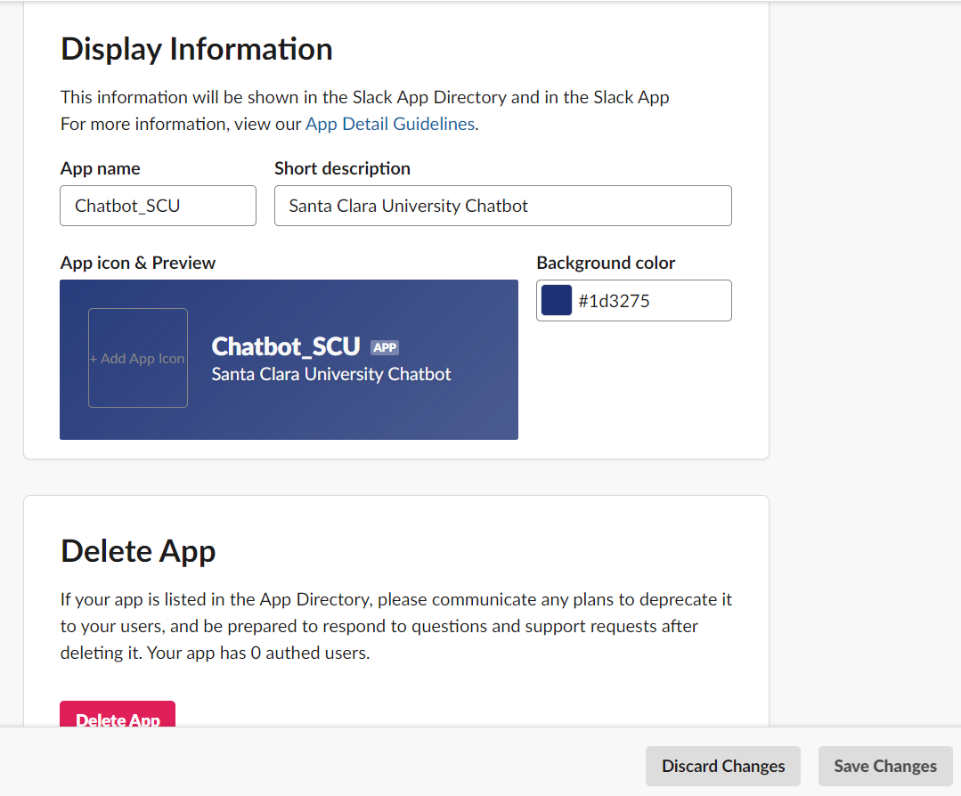
Final App’s configurations

